Slide 1
VJIT Hackathon
Title: AgroHub.AI (A Platform to encourage Precision Agriculture)
Team Name: Gradient
Team No.: 33
Team:
G Hemanthsai
R Sairam
S Riyaz
J Dhana Shekhar
Institute:
Vidya Jyothi Institute of Technology

Slide 2
Problem Statement:
According to United Nations survey the world population will increase from 7.5 billion to 9.7 billion in 2050.
This means the farmers have to do more with the less. And the same survey says that the food production have to increased by 60% to feed the entire population. The existing agricultural methods are not enough to serve such as detecting the crop diseases and choosing the right crop etc,. and handle the increasing demand. It is a challenge to increase the global production by 60% by 2050.

Slide 3
Solution:
The solution for the above problem can be using AI in Agriculture.
AI powered agriculture solutions will help to improve the quality and efficiency of the production.
We have developed a platform to encourage precision agriculture where in the farmers can use the ready to use ML models for Crop Recommendation and Crop Disease Detection.
Farmers can post their queries in the discussion form and can answer the queries of other farmers.
Our platform is open to all the developers where in they can contribute to our platform by developing the ML models for precision agriculture. The contributed work is reviewed and deployed on our platform.

Slide 4
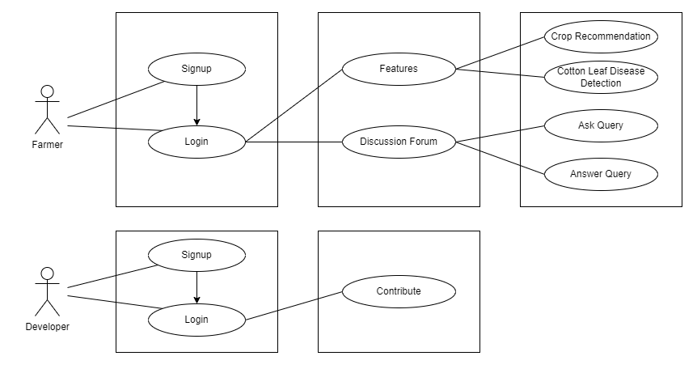
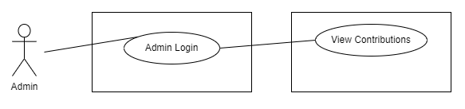
Use Case Diagram

Slide 5
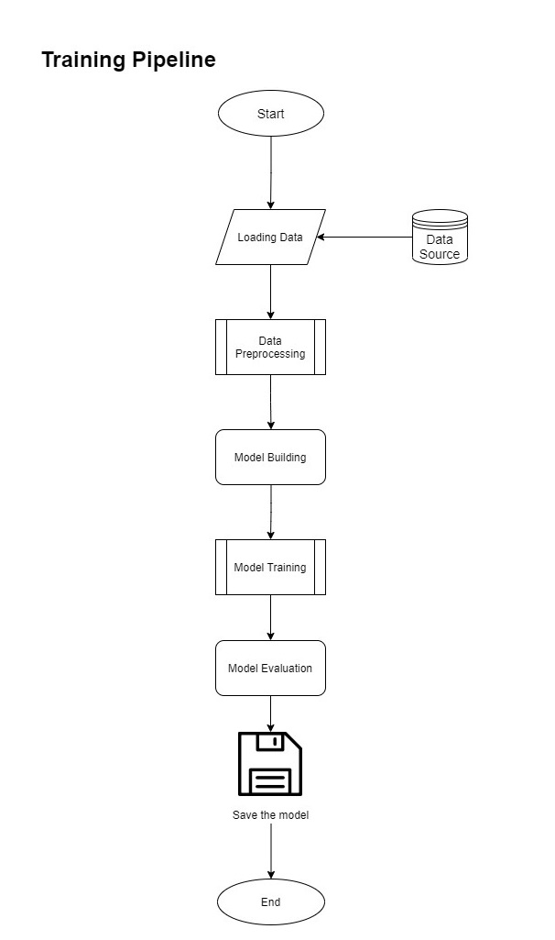
Machine Learning Model Development Workflow

Slide 6
Technical Stack
PYTHON
FLASK
MONGODB
TENSORFLOW
WINDOWS /UBUNTU OS
USER’S BROWSER
HTML (MARKUP LANGUAGE) CSS (STYLE SHEET)
User’s side
Server Side

Slide 7
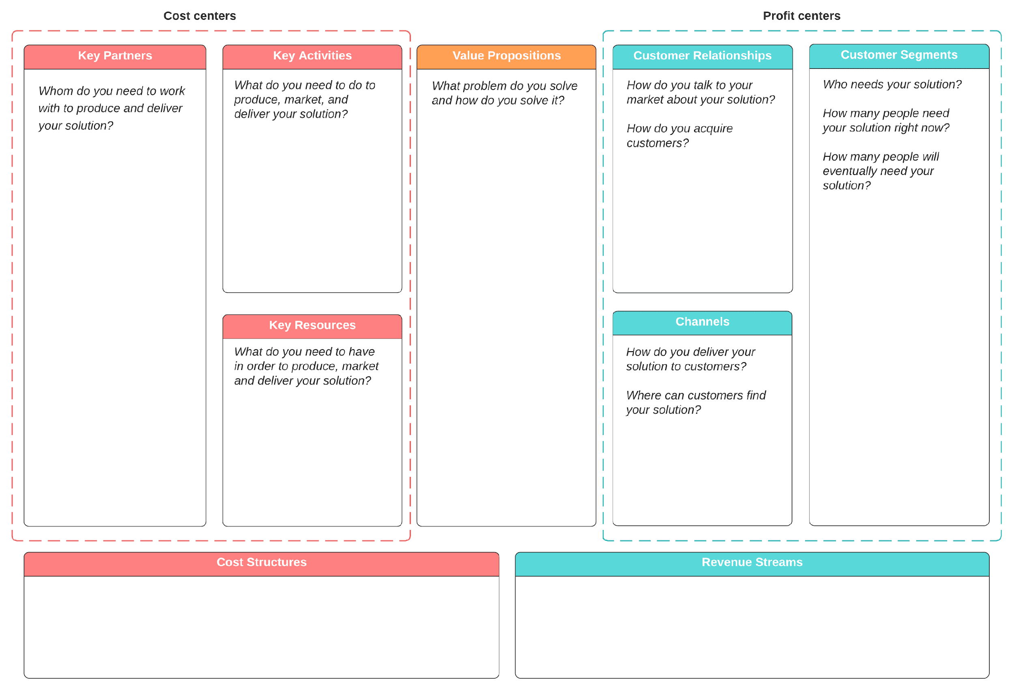
Business Model
We have to interact with the farmers to bring awareness among them about the precision agriculture. And also encourage the developers to contribute to our platform.
We need lots of real time data to accurately train the ML/DL models.
We need to work with organization who are working on Artificial Intelligence.
We solve the problem of manually crop disease detection and choosing the right crop to cultivate.
Instead of farmers selecting the crops and detecting the diseases we solve that problem by using Machine Learning & Deep Learning.
We will explain the need for Precision Agriculture.
We acquire customers by conducting awareness campaigns.
Thank You…
Farmer need our solution
Right now Precision Agriculture is at the initial state.
Eventually the need for this will raise.
We need farmers who give the feedback,
developers who can build models
We deliver our solution through a website.

Slide 8
Thank You…

